Slide 1
Lecture 22: LM3S9B96 Microcontroller – SysTick and General-Purpose Timers

Slide 2
Stellaris® LM3S9B96 Microcontroller
Data Sheet
Chapter 2.2.8
System Timer (SysTick)
Chapter 11
General-Purpose Timers

Slide 3
System Timer
Cortex-M3 includes an integrated system timer, SysTick
Provides a simple, 24-bit clear-on-write, decrementing, wrap-on-zero counter
  An RTOS tick timer which fires at a programmable rate (for example, 100 Hz) and invokes a SysTick handler routine
  A high-speed alarm timer using the system clock
  A variable rate alarm or signal timer
  A simple counter used to measure time to completion and time used

Slide 4
Functional Description
The timer consists of three registers:
  SysTick Control and Status Register: a control and status counter to configure its clock, enable the counter, enable the SysTick interrupt, and determine counter status
  SysTick Reload Value Register: the reload value for the counter, used to provide the counter's wrap value
  SysTick Current Value Register: the current value of the counter
Note: the SysTick Calibration Value Register, is not implemented in the Stellaris devices

Slide 5
Functional Description
When enabled, the timer counts down on each clock from the reload value to zero
Reloads (wraps) to the value in the SysTick Reload Value register on the next clock edge, then decrements on subsequent clocks
Clearing the SysTick Reload Value register disables the counter on the next wrap
When the counter reaches zero, the COUNTFLAG status bit is set (clears on reads)
Writing to the SysTick Current Value register clears the register and the COUNTFLAG status bit
On a read from the SysTick Current Value register , the current value is the value of the register at the time the register is accessed
If the core is in debug state (halted), the counter does not decrement

Slide 6
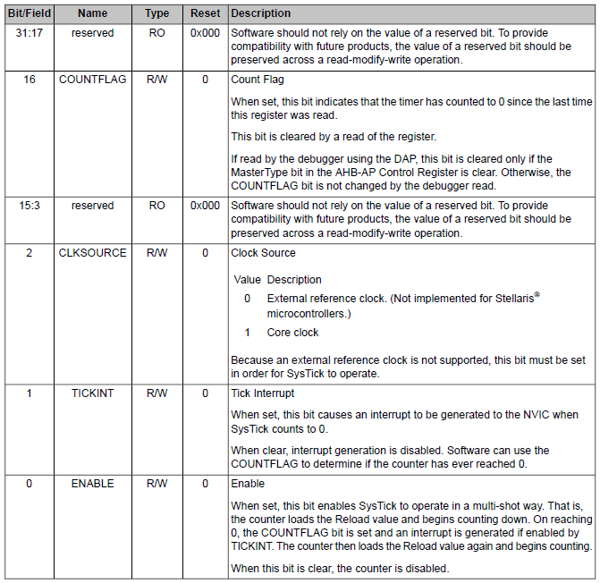
SysTick Control and Status Register

Slide 7
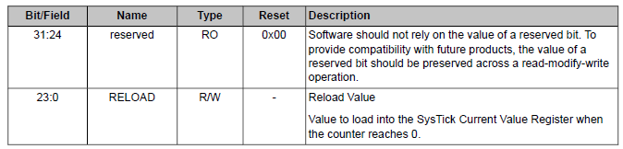
SysTick Reload Value Register
The start value N can be between 1 and 0x00FF.FFFF, firing every N+1 clock.
  For example, if a tick interrupt is required every 100 clock pulses, 99 must be written into the RELOAD field

Slide 8
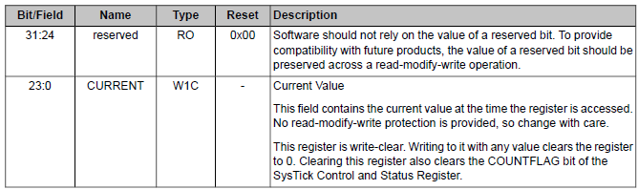
SysTick Current Value Register
The SysTick Current Value Register contains the current value of the counter.

Slide 9
General-Purpose Timers
Programmable timers can be used to count or time external events that drive the Timer input pins
The Stellaris General-Purpose Timer Module (GPTM) contains four GPTM blocks
Each GPTM block provides two 16-bit timers/counters
  can be configured to operate independently as timers or event counters
  or configured to operate as one 32-bit timer or one 32-bit Real-Time Clock (RTC)

Slide 10
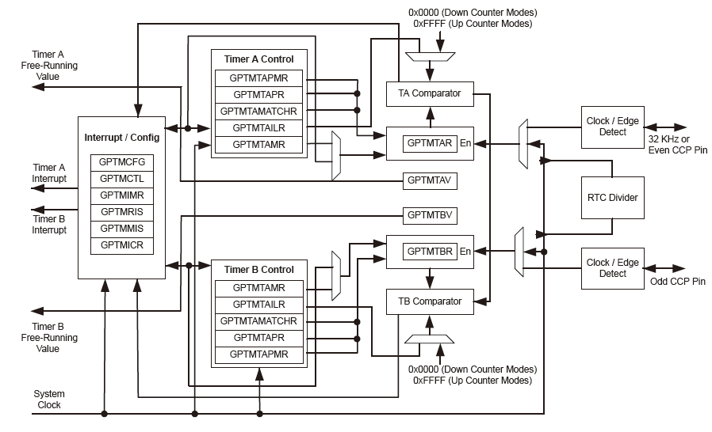
Block Diagram

Slide 11
Initialization and Configuration
To use the general-purpose timers, the peripheral clock must be enabled by setting the TIMER0, TIMER1, TIMER2, and TIMER3 bits in the RCGC1 register
If using any CCP pins, the clock to the appropriate GPIO module must be enabled via the RCGC2 register and configure the PMCn fields in the GPIOPCTL register to assign the CCP signals to the appropriate pins
32-Bit One-Shot/Periodic Timer Mode
32-Bit Real-Time Clock (RTC) Mode
16-Bit One-Shot/Periodic Timer Mode
Input Edge-Count Mode
16-Bit Input Edge Timing Mode
16-Bit PWM Mode

